Slide 1
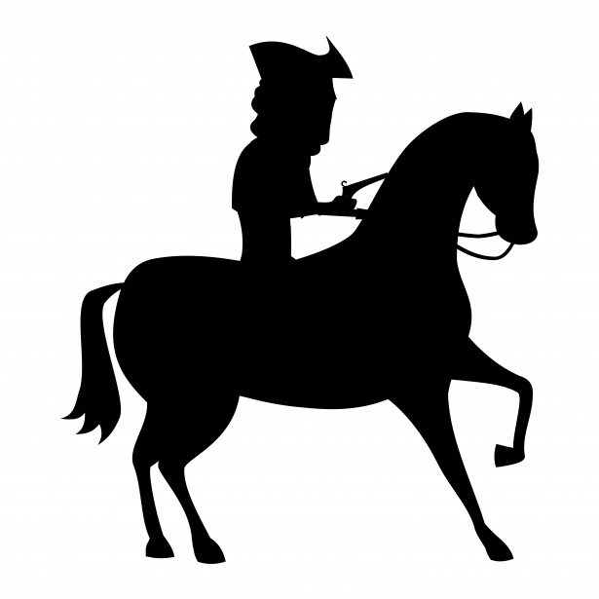
The Highwayman by Alfred Noyes
The wind was a torrent of darkness among the gusty trees,
The moon was a ghostly galleon tossed upon cloudy seas.
The road was a ribbon of moonlight over the purple moor,
And the highwayman came riding –
Riding – riding –
The highwayman came riding, up to the old inn-door.

Slide 2
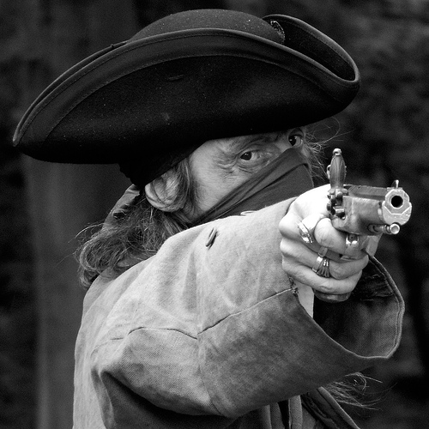
He’d a French cocked-hat on his forehead,
a bunch of lace at his chin,
A coat of the claret velvet, and breeches of brown doe-skin.
They fitted with never a wrinkle.
His boots were up to the thigh.
And he rode with a jewelled twinkle,
His pistol butts a-twinkle
His rapier hilt a-twinkle, under the jewelled sky.

Slide 3
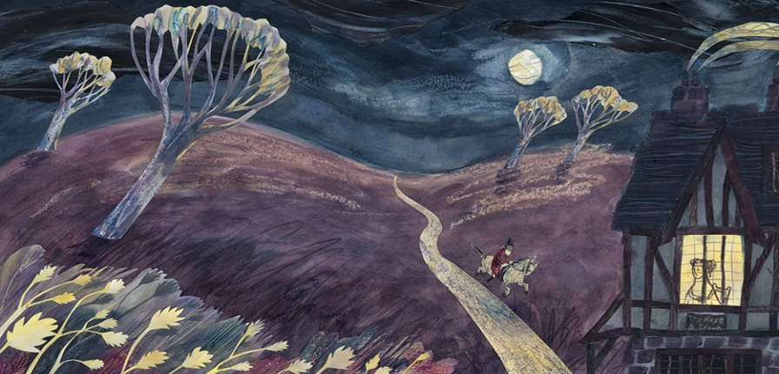
Over the cobbles he clattered and clashed in the dark inn-yard.
He tapped with his whip on the shutters, but all was locked and barred.
He whistled a tune to the window, and who should be waiting there
But the landlord’s black-eyed daughter, Bess, the landlord’s daughter,
Plaiting a dark red love-knot into her long dark hair.

Slide 4
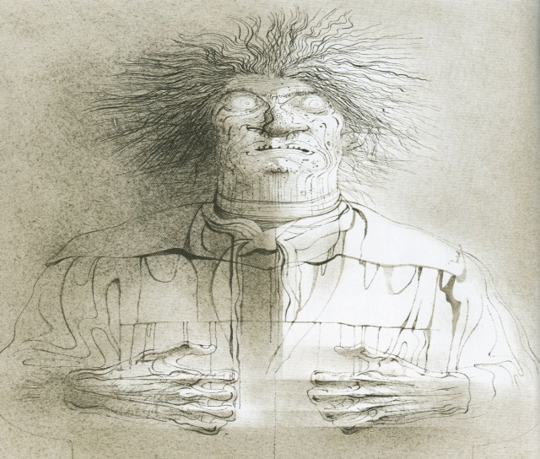
And dark in the dark old inn-yard a stable-wicket creaked
Where Tim the ostler listened. His face was white and peaked.
His eyes were hollows of madness, his hair like mouldy hay,
But he loved the landlord’s daughter,
The landlord’s red lipped daughter
Dumb as a dog he listened, and he heard the robber say -

Slide 5
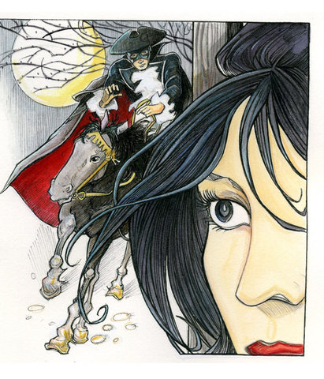
‘One kiss, my bonny sweetheart, I’m after a prize to-night,
But I shall be back with the yellow gold before the morning light;
Yet, if they press me sharply, and harry me through the day,
Then look for me by moonlight,
Watch for me by moonlight,
I’ll come to thee by moonlight, though hell should bar the way.’

Slide 6
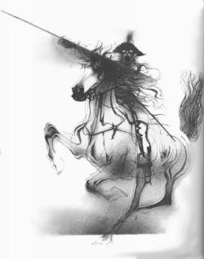
He rose upright in the stirrups. He scarce could reach her hand,
But she loosened her hair i’ the casement. His face burnt like a brand
As the black cascade of perfume came tumbling over his breast;
And he kissed its waves in the moonlight,
(oh, sweet black waves in the moonlight!)
Then he tugged at his rein in the moonlight, and galloped away to the west.

Slide 7
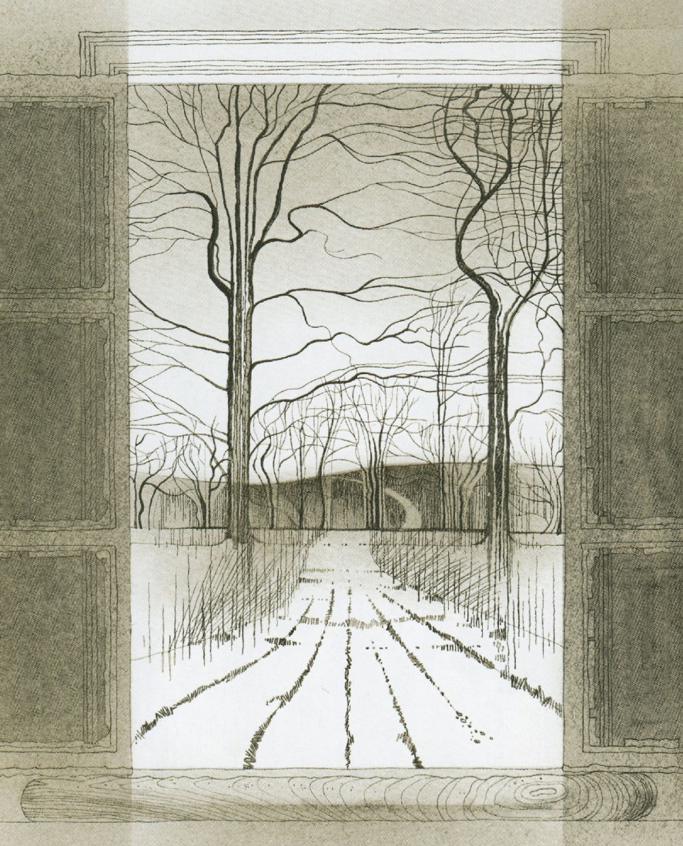
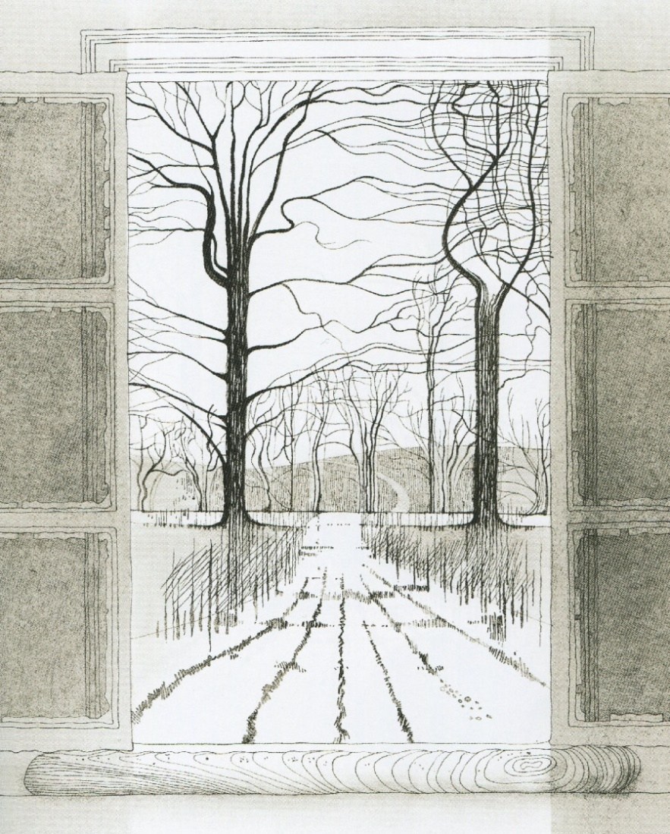
He did not come in the dawning.
He did not come at noon;

Slide 8
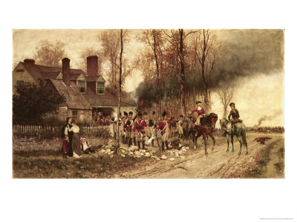
And out o’ the tawny sunset, before the rise o’ the moon,
When the road was a gipsy’s ribbon, looping the purple moor.
A red-coat troop came marching –
Marching – marching
King George’s men came marching, up to the old inn-door.
They said no word to the landlord. They drank his ale instead.

Slide 9
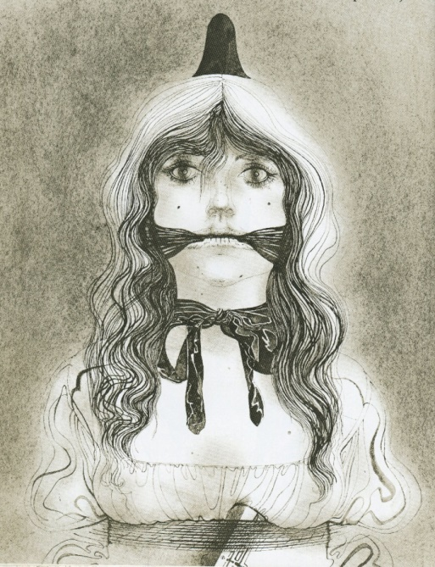
But they gagged his daughter, and bound her, to the foot of her narrow bed.
Two of them knelt at her casement, with muskets at their side!
There was death at every window;
And hell at one dark window;
For Bess could see, through her casement, the road that he would ride.

Slide 10
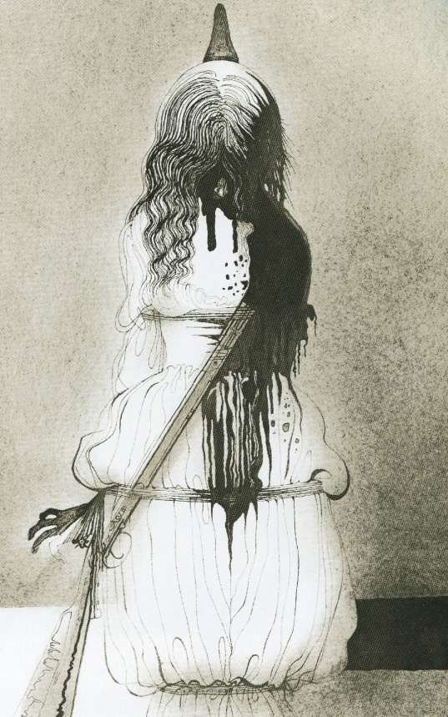
They had tied her up to attention, with many a sniggering jest.
They had bound a musket beside her, with the nuzzle beneath her breast!

Slide 11
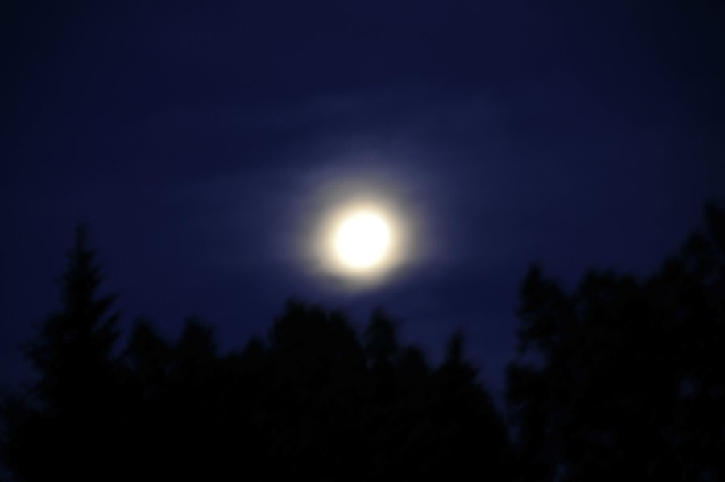
Now, keep good watch!’ and they kissed her.
She heard the dead man say –
Look for me by the moonlight; watch for me by the moonlight;
I’ll come to thee by moonlight, though hell should bar the way !
She twisted her hands behind her; but all the knots held good!
She writhed her hands till her fingers were wet with sweat or blood!
They stretched and strained in the darkness, and the hours crawled back like years,

Slide 12

Tlot-tlot; tlot-tlot! Had they heard it? The horse-hoofs ringing clear;
Tlot-tlot; tlot-tlot, in the distance! Were they deaf that they did not hear?

Slide 13
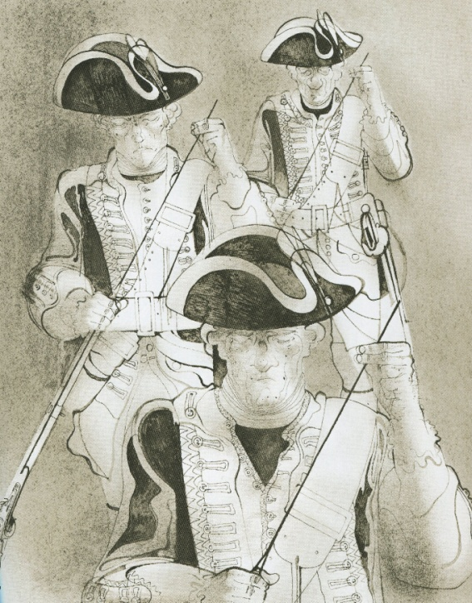
Down the ribbon of moonlight, over the brow of the hill, The highwayman came riding, riding, riding!
The red-coats looked to their priming!
She stood up, straight and still.

Slide 14
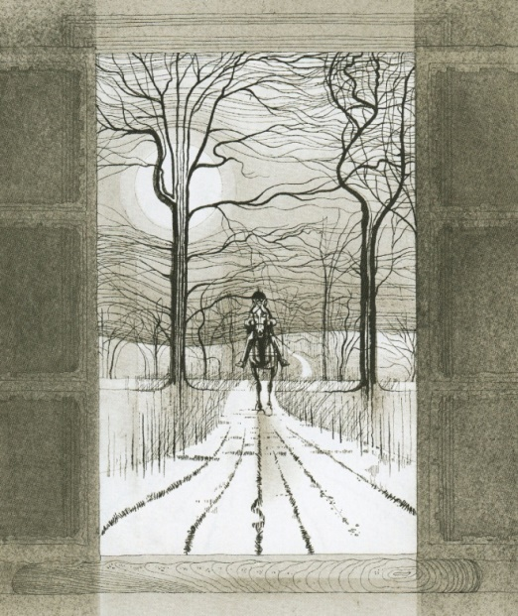
Tlot-tlot, in the frosty silence! Tlot-tlot in the echoing night!
Nearer he came and nearer. Her face was like a light.
Her eyes grew wide for a moment; she drew one last deep breath,
Then her finger moved in the moonlight, her musket shattered the moonlight. Shattered her breast in the moonlight and warned him – with her death.

Slide 15
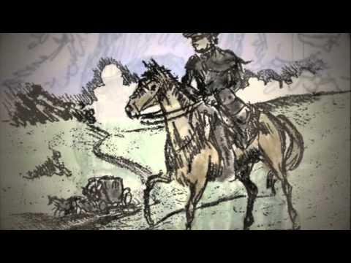
Back, he spurred like a madman, shouting a curse to the sky,
With the white road smoking behind him and his rapier brandished high

Slide 16
Blood-red were his spurs i’ the golden noon; wine-red was his velvet coat;
When they shot him down on the highway,
Down like a dog on the highway,
And he lay in his blood on the highway, with a bunch of lace at his throat.

Slide 17
And still of a winter’s night, they say, when the wind is in the trees
The moon was a ghostly galleon tossed upon cloudy seas.
The road was a ribbon of moonlight over the purple moor,

Slide 18
And the highwayman came riding –
Riding – riding –
The highwayman came riding, up to the old inn-door.

Slide 19
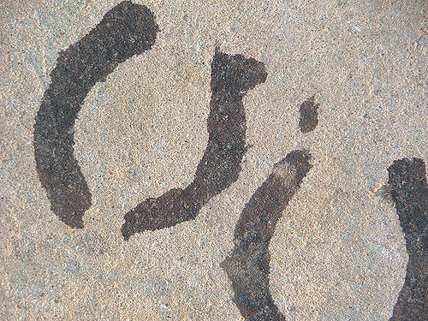
Over the cobbles he clattered and clashed in the dark inn-yard.
He tapped with his whip on the shutters, but all was locked and barred.

Slide 20
He whistled a tune to the window, and who should be waiting there
But the landlord’s black-eyed daughter, Bess, the landlord’s daughter,
Plaiting a dark red love-knot into her long dark hair.

Slide 21
The End

